Slide 1


Data Structures
Lab # 2

Slide 2

Conditional Statement
A conditional statement in C++ controls program flow by executing code only when a Boolean condition is met
Reference: Michael T. Goodrich, Roberto Tamassia, and Michael H. Goldwasser, Data Structures and Algorithms in Java, 6th ed., Wiley, 2014

Slide 3
If
if (condition) {
// runs when condition is true
}
Reference: Michael T. Goodrich, Roberto Tamassia, and Michael H. Goldwasser, Data Structures and Algorithms in Java, 6th ed., Wiley, 2014

Slide 4
If else
if (condition) {
// true branch
} else {
// false branch
}
Reference: Michael T. Goodrich, Roberto Tamassia, and Michael H. Goldwasser, Data Structures and Algorithms in Java, 6th ed., Wiley, 2014

Slide 5
If else
if (condition) {
// true branch
} else {
// false branch
}
Reference: Michael T. Goodrich, Roberto Tamassia, and Michael H. Goldwasser, Data Structures and Algorithms in Java, 6th ed., Wiley, 2014

Slide 6
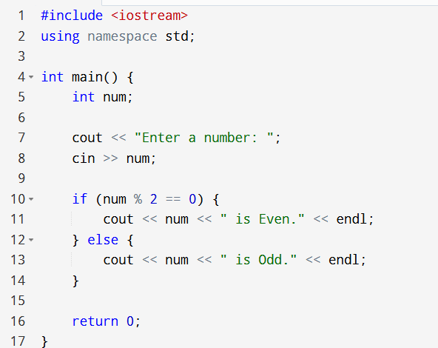
If else
Reference: Michael T. Goodrich, Roberto Tamassia, and Michael H. Goldwasser, Data Structures and Algorithms in Java, 6th ed., Wiley, 2014

Slide 7
Control Structures
In C++, loops are control structures that repeatedly execute a block of code as long as a specified condition is true.
Reference: Michael T. Goodrich, Roberto Tamassia, and Michael H. Goldwasser, Data Structures and Algorithms in Java, 6th ed., Wiley, 2014

Slide 8
For loop
for (initialization; condition; update)
{
// code to be executed repeatedly
}
Initialization
Runs once at the beginning.
Usually used to declare and set a counter variable.;
Condition
Checked before each iteration.
If true, the loop body runs; if false, the loop stops.
Example: i <= 5
Update (Increment/Decrement)
Runs after each iteration.
Usually increases or decreases the counter variable.

Slide 9
While Loop
while (condition) {
// code block
}
The condition is checked first.
If it is true, the code inside the loop runs.
After running, the condition is checked again.
The loop stops when the condition becomes false

Slide 10
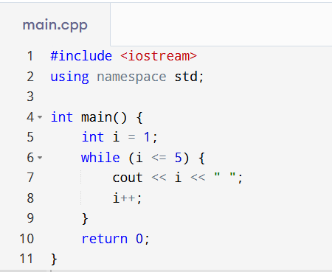
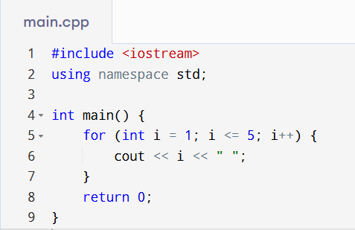

Slide 11
Do while
do {
// code block
} while (condition);
The code block runs first (without checking the condition).
Then the condition is tested.
If the condition is true, the loop runs again.
If the condition is false, the loop stops

Slide 12
Do while
do {
// code block
} while (condition);
The code block runs first (without checking the condition).
Then the condition is tested.
If the condition is true, the loop runs again.
If the condition is false, the loop stops

Slide 13
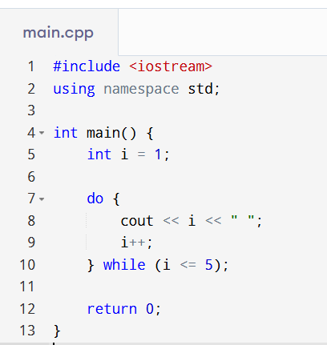

Slide 14

THANK YOU!

